Slide 1
Introduction to Python - Python 102
Goal: Review concepts learned from Python 101 and introduce new concepts for Python 102 (control flow, loops, and functions)

Slide 2

What We’ll Cover Today
Python 101 Review
Python 102 Key Terms and Concepts
Python Reference and Documentation
Preparing for what’s next

Slide 3
Python 101 Review

Slide 4
What are objects in Python and what are their 3 main properties?
Notes:
Everything in Python is an object. The 3 main properties of an object are its attributes, methods, and type

Slide 5
What do we use to both store and refer to objects?
Notes:
Variables are used to store and refer to objects

Slide 6
What are some of the basic data types in Python?
Notes:
Int, float, string, boolean, list, dictionary, tuple, etc

Slide 7
What were the “container” data types that we covered?
Notes:
Strings, lists, tuples, and dictionaries

Slide 8
What’s the difference between a list and a tuple?
Notes:
Lists are mutable, tuples are immutable
Lists are created using square brackets ([]) and tuples using parentheses

Slide 9
Python 102 Key Terms & Concepts

Slide 10
Control Flow
Lets us control the flow of code execution
Similar to IF, IFS in Excel and CASE WHEN in SQL
Python uses if, elif (short for “else if”,) and else
Let’s implement the following example using Excel and then Python:
If a value is greater than or equal to 10, say “High”. If it is between 6 and 9, say “Medium”. Otherwise, say “Low”.

Slide 11
Control Flow (continued)
Excel version:
IFS(A1 >= 10, “High”,
AND(A1 >= 6, A1 <= 9), “Medium”,
A1 < 6, “Low”)

Slide 12
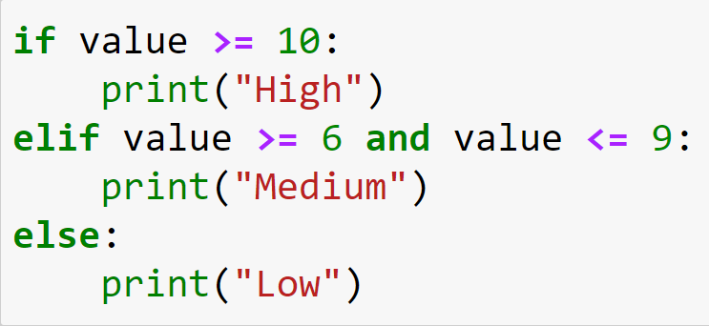
Control Flow (continued)
Python Version:
Notes:
NOTE (Captains): This could be a good time to start using PythonTutor to run examples of this and the following concepts live to help explain what’s going on. This doc explains how to do that and has sample code for you to use.
To drive the point home, you can ask COOPers what the output would be for a value that you give them. For example, say the value is 11 - ask them what the above code would print out (Answer: “High”). You can use this to help ensure that they understand how the result may change depending on the given input.

Slide 13
Loops
In Python, loops are used to run code repeatedly. There are two types of loops that we generally write:
for loops run through items in containers
while loops run until a ‘stop’ condition is reached

Slide 14
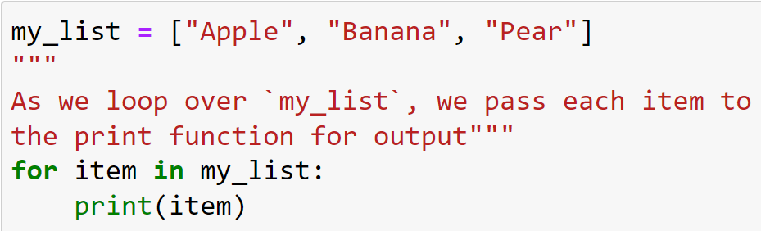
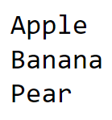
Loops (continued)
for loop:
Output:
Notes:
This is a simple example of a for loop that loops through a container called ‘my_list’ and prints each item in that list

Slide 15
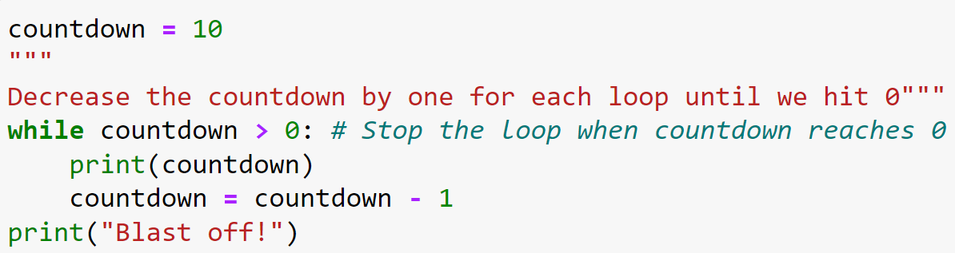
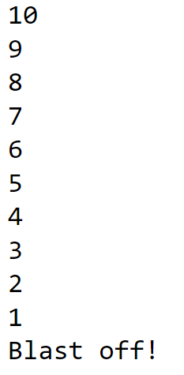
Loops (continued)
while loop:
Output:
Notes:
NOTE: When creating a while loop, you must be careful with selecting the condition(s) used to control it. Since the loop runs while the given condition is true, it is possible to create an infinite loop that runs until the program crashes. An example of this would be:
while 1 == 1:
print(“Dormammu, I’ve come to bargain…”)
Since 1 == 1 will always be true, this loop never ends. This is a trivial example, but meant to show that it is possible to create infinite loops and that students should be careful to avoid this (unless the behavior is desired.)

Slide 16
Functions
We have gone over functions in both Excel and SQL, so this should be familiar
The difference with Python is that we often define our own functions in addition to using built-in ones
We can define functions that perform an action or return the value of a calculation (or both)
We use the ‘return’ keyword to end the function execution and return a result

Slide 17
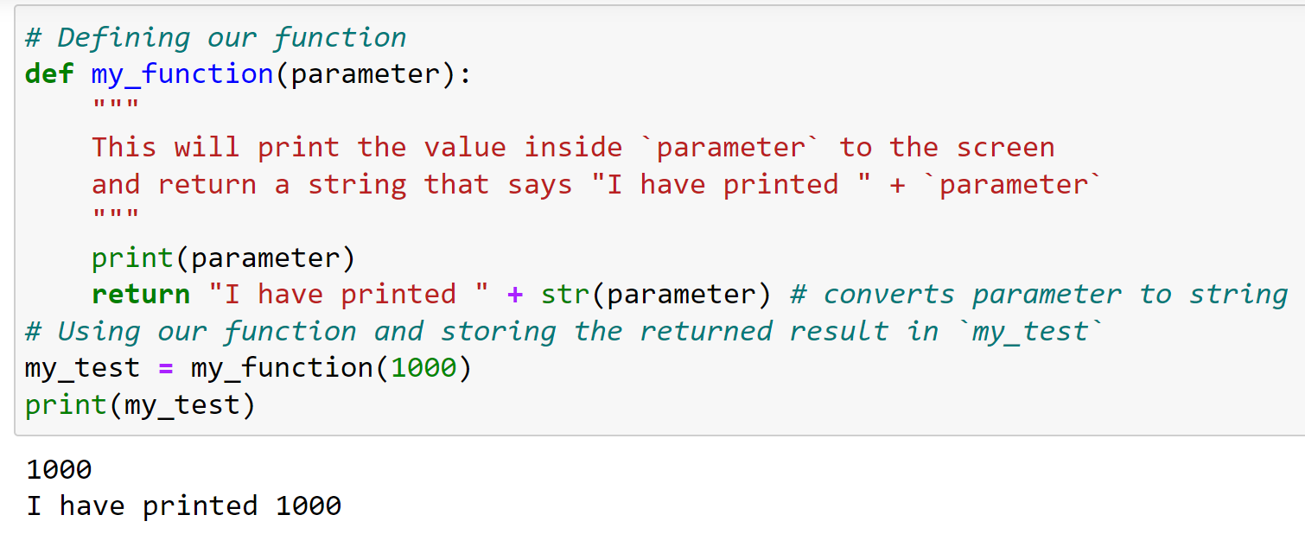
Functions (continued)
Example:

Slide 18
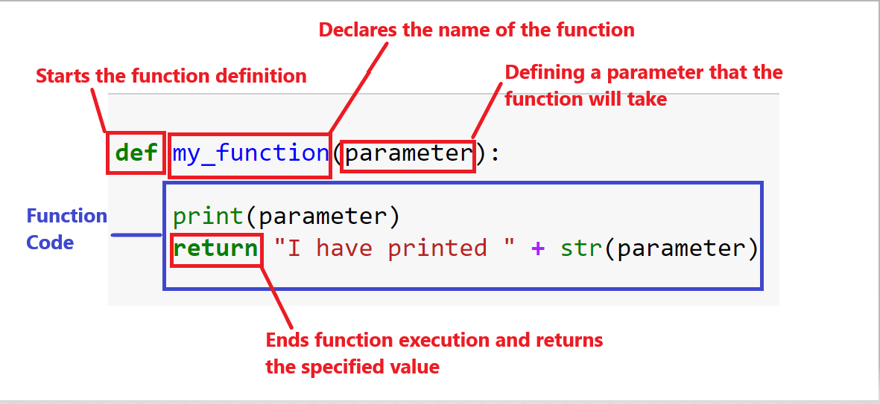
Functions (continued)

Slide 19
Indentation & Code Blocks
Up until now, we have only dealt with a single block of code. With control flow, loops, and functions, we introduce the concept of code blocks
Code blocks are still code, but what is different about this code is when it gets executed
Blocks of code in functions, control flow, or loops only get executed when the function, control flow, or loop runs
Code blocks are always preceded by a colon (“:”) and must be indented by at least one space from the previous line (common practice is indenting by four (4) spaces).
Example:
I am a block of code:
I am another block of code

Slide 20
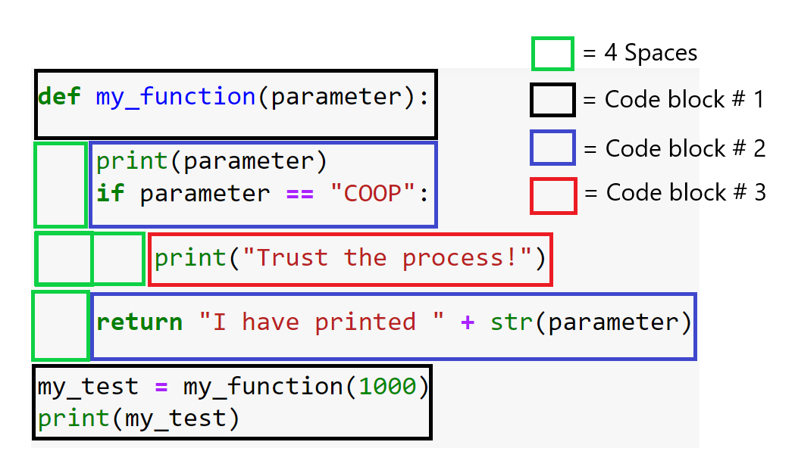
Indentation & Code Blocks (continued)
Notes:
This is a visual representation of code blocks and spacing/indentation. Each green block represents 4 spaces. All new code blocks are preceded by a colon (“:”) and should be indented by a minimum of 1 space (4 spaces is the standard convention, though.) This is relevant for loop blocks and control flow blocks.

Slide 21
Reference and Documentation

Slide 22
Python Documentation and Reference
It’s important to know how to find help whenever you encounter problems coding
Thankfully, there are many free resources available from the community to help with Python
For help with syntax or available features, the best place to start is the documentation
W3 Schools
Official Python Documentation
Other popular resources include Stack Overflow & Reddit
When in doubt, Google to find out

Slide 23
What’s next and how to prepare?

Slide 24
Preparing for future lessons
The next lessons introduce Pandas and MatPlotLib
Get familiar with Pandas before our next lesson
Keep practicing what we learned in Python 101 & 102 throughout the week
Here are some resources to use to help you get ready

Slide 25
Let’s get back to coding!

